Slide 1

ShopCrawl: Make Shopping a Party
ShopCrawl

Slide 2



Meet our team
Anthony R.
Luke M.
Isaac P.
Co-term in Computer Science on the HCI track. Did my undergraduate in Economics. Born and raised in New York City.
Undergrad studying Computer Science on the HCI track. Member of the varsity Men’s Volleyball team.
Co-term in Computer Science. Senior in Economics. Grew up in New Jersey.

Slide 3
The Problem:
Chore shopping is boring and monotonous.
It’s hard for people to meet new people.
Time is valuable.

Slide 4
The Solution:
Make shopping fun through social experiences.

Slide 5
Our Value: Exploration
At a glance
We aim to assist in helping younger adults begin to explore more. Given the nature of our product, we decided this should be our focus.
Explore new shop and products
Make new shopping buddies by meeting like minded individuals in the area
Rather than treating shopping as an isolated or purely transactional task, our design encourages users to discover, plan, and shop together

Slide 6
What features will express this value
We centered on three methods:
Community events
Crawl customization
Social features
Through these, we will can achieve our focus of exploration. In each, exploration exists: explore community events, explore new ways to crawl, and explore friends

Slide 7
Value Tensions
“In person” social app
Since we are an online app that centers on bringing people together offline, this very dynamic is a tension. We can aim to solve this through ensuring that our app is not a replacement for true social encounters, but the method in which these events occur.
Inclusivity
People may bring their already existing friends, and be less willing to meet new members from the community. This has the potential to breed inclusivity. We aim to minimize this by encouraging people to meet new other community members by setting their Crawls to public, where anyone can join.
Buy In
Exploration occurs only if members want to meet new people and want to try new places. We believe that by motivating people to try new places (through app-exclusive discounts for example) and meet new people is enough to overcome this tension.

Slide 8
Our Tasks
Simple: Join a Crawl.
The main use case of ShopCrawl is to join Crawls where you can
go on social shopping experiences. Joining a Crawl will be the
task most users do when they open the app.
Moderate: Create Crawls.
Once users are comfortable with participating in already created
Crawls, they have the option to create their own Crawls. This
feature is used by intermediate users who want to further
contribute to the community.
Complex: Connect with people from past Crawls.
Most public crawls will include Crawlers that users have not met.
Users who are ready to make a new friend and take their social
experience outside of ShopCrawl can connect with Crawlers.

Slide 9
Usability Goals and Key Measurements
Goal 1: Engagement and Eagerness
Why: As a social-based app, users should feel motivated to participate in or return to future crawls after using the prototype.
Key Measurements: Observations of enthusiasm and engagement.
Ask users: “1-5, how interested are you in using
ShopCrawl again?” Aim for > 4 average.
Goal 2: Efficiency and Ease of Use
Why: It's important that our app is easy to understand and accessible for different users to enable people from different backgrounds to participate
Key Measurements: Time spent on the last task from “Past Crawls”.
Ask users: “1-5, how easy was it to complete the
last task?” Aim for > 4 average.

Slide 10
How our product is hitting these goals
Next Changes to hit goals
Our product effectively meets our usability goals by keeping navigation intuitive and visually consistent, reducing friction for users as they move through each task. The social and interactive elements, like viewing friends and adding crawlers, encourage engagement and make the experience feel active and community-driven. It also hits the efficiency and ease-of-use goal by keeping navigation simple and consistent enabling users to move between screens with minimal steps, clear feedback, and intuitive button placement that reduces decision time. Overall, the design balances clarity and enjoyment, promoting both ease of use and eagerness to return.
To better hit these goals we plan to implement the following:
Expand the metrics we collect beyond final task time. By tracking misclicks, backtracks, and hesitation points, we can better identify friction in the flow and quantify improvements in efficiency over time.
Systematically address high-severity incidents. View systemic reports that users are sending to be able to identify problems before they arise
Improve visual hierarchy and consistency. By constantly refining component spacing, color contrast, and typography will help users navigate faster and with fewer errors, directly raising “Ease of Use” ratings above our >4 goal.

Slide 11
Core Change 1: Report Button
Core 1st change: Users flagged safety concerns. wanting a way to report or block others before connecting. Added a visible “Report User” option on profiles and after crawls, and added post-crawl rating/review screens to build trust.
How to affects our goal and measurement: This boosts willingness to use again by removing the biggest bottleneck. This helps to increase overall engagement and eagerness
Notes:
Note the report buttons on the bottom of the profile. Additionally, we focused on making a very strong report feature. We also made a conscious decisions to change our back / cancel button on the reporting to have something that is stronger because of higher importance of this topic. We had felt this was more mature and responsible and shower more agency.

Slide 12
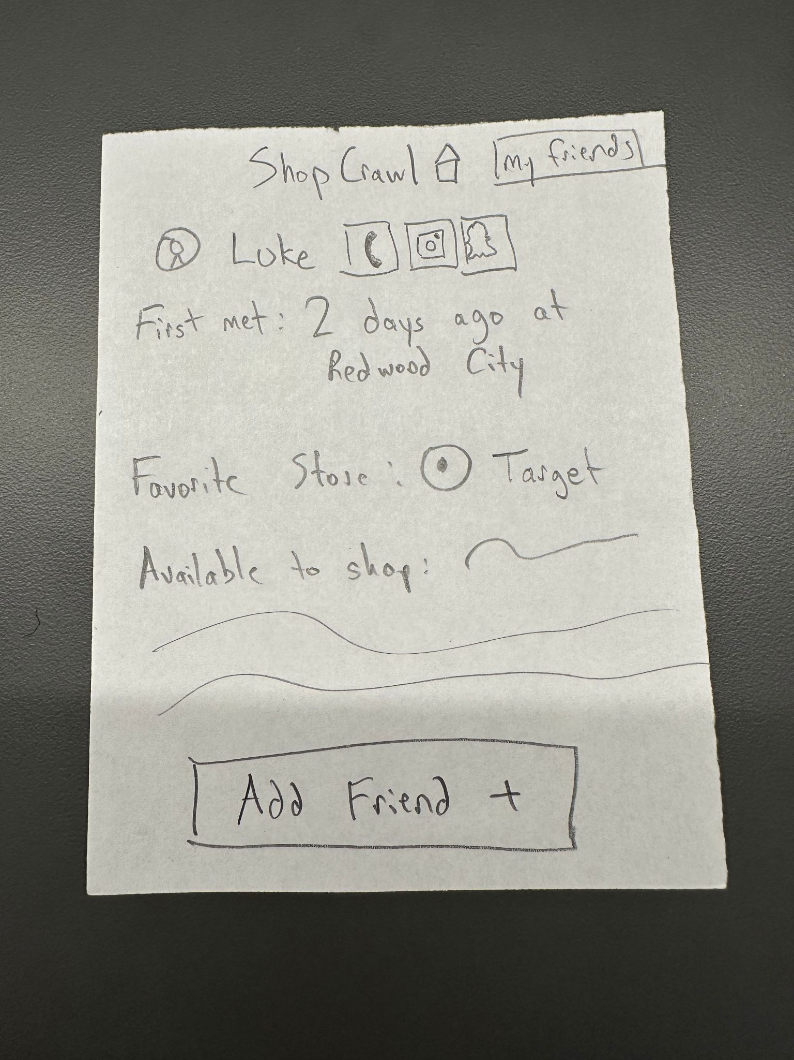
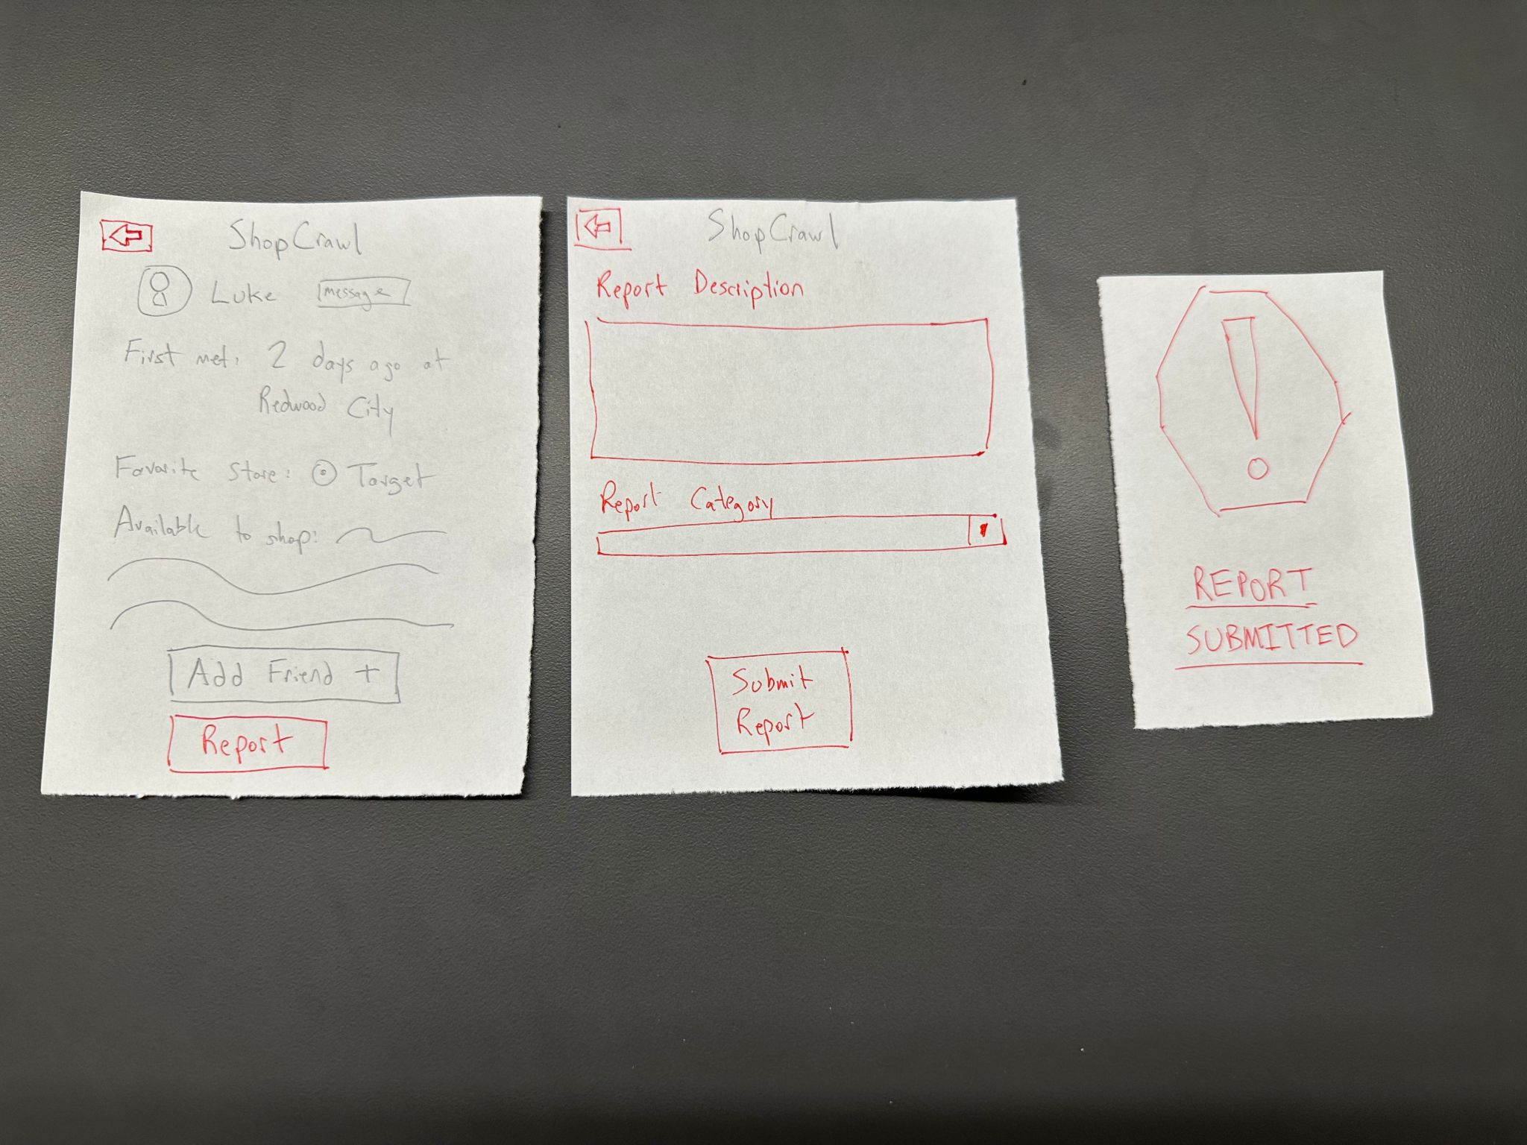
Core Change 1: Report Button
Original Crawler Profile
After Change: Added report button, report description page, and report submission confirmation.
Notes:
Note the report buttons on the bottom of the profile. Additionally, we focused on making a very strong report feature. We also made a conscious decisions to change our back / cancel button on the reporting to have something that is stronger because of higher importance of this topic. We had felt this was more mature and responsible and shower more agency.

Slide 13
Core change 2: User Confirmation
Core 2st change: Feedback from testing revealed that users were often unsure whether their actions, such as reporting a user, or confirming a crawl, had gone through successfully. To address this, we added confirmation screens and status alerts that clearly show when an action is completed (e.g., “Report Submitted”). These small but visible cues build user confidence and make the flow feel more responsive and intentional.
How to affects our goal and measurement:Providing clear confirmations directly improves Efficiency and Ease of Use by reducing user hesitation and preventing repeated actions. It also enhances Engagement, since users now receive immediate visual feedback for every completed step.

Slide 14
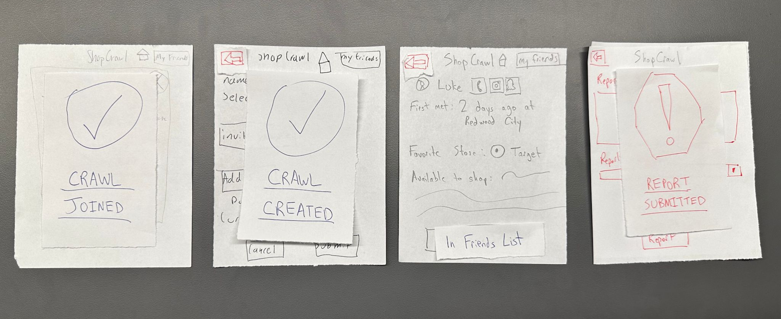
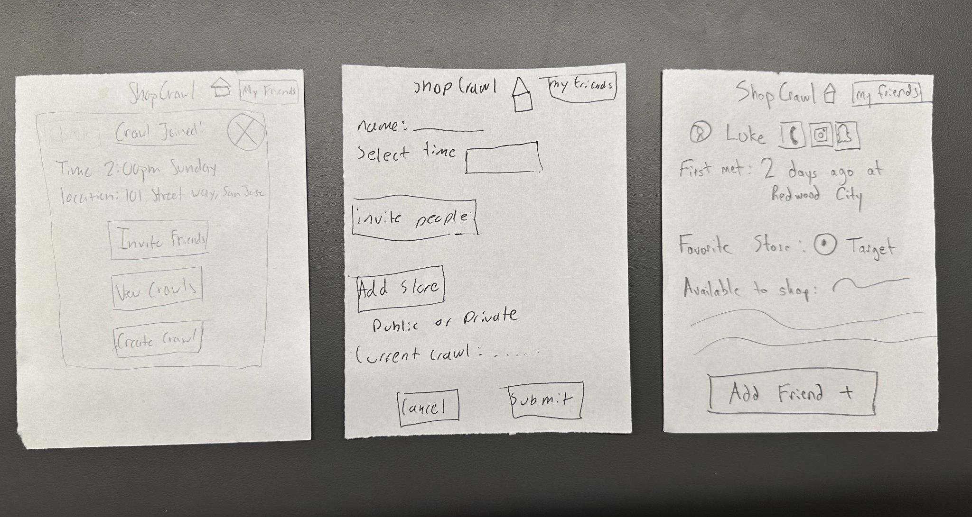
Core change 2: User Confirmation
Original Pages with Action Items
After Change: Added confirmation popups for Crawl Joined, Crawl Created, and Report Submitted. Added a visual change in the profile after you add a friend,letting you know that they are now in your friends list.

Slide 15
Core change 3: Standardized Layout & Hierarchy
Core 3rd change: Feedback from testing and the TA noted inconsistencies in spacing, sizing, and alignment across screens, which affected the app’s clarity. In our revised sketch, we standardized the layout and hierarchy which included aligning components, unifying text sizes, and maintaining consistent button placement across pages. These refinements improve scannability and make the overall interface feel more cohesive and predictable.
How to affects our goal and measurement: By improving visual structure, users can now process information faster and move through tasks with fewer misclicks or hesitations. This directly strengthens our Efficiency and Ease of Use goal, helping us achieve shorter task times and higher “ease of use” ratings (aiming for >4 average).

Slide 16
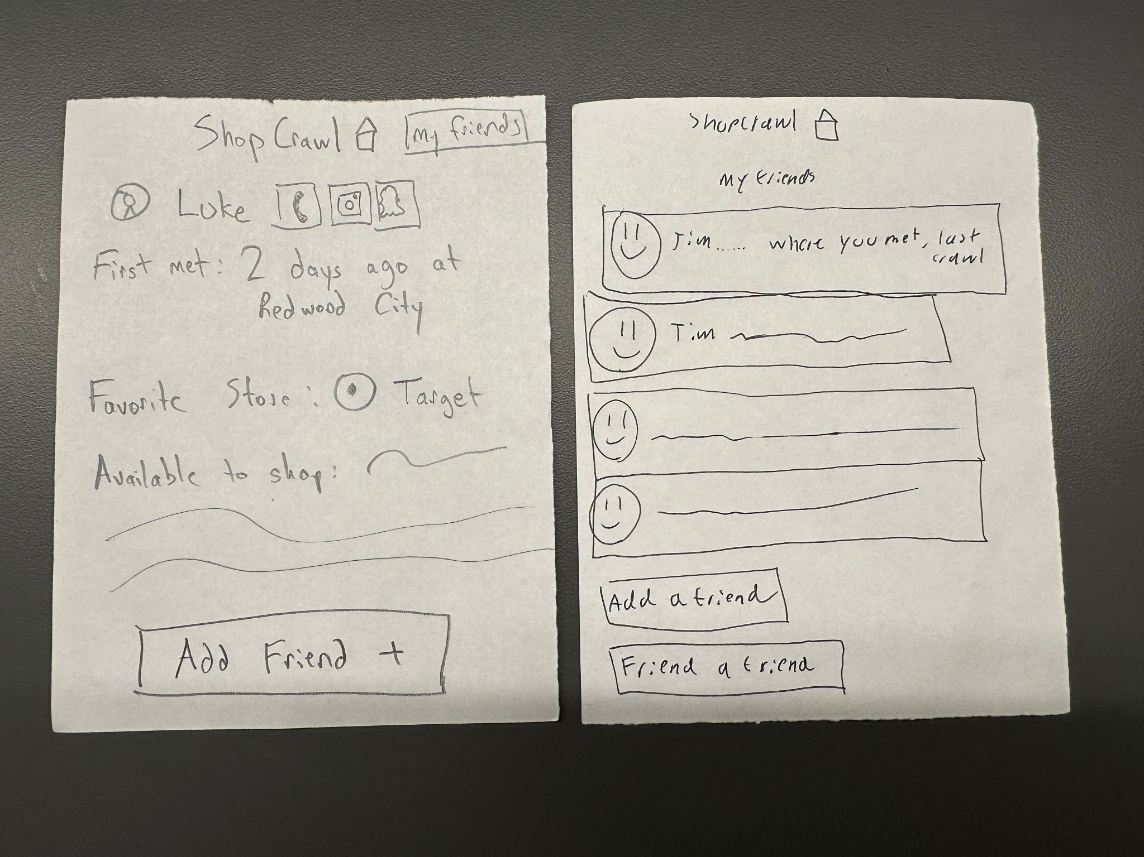
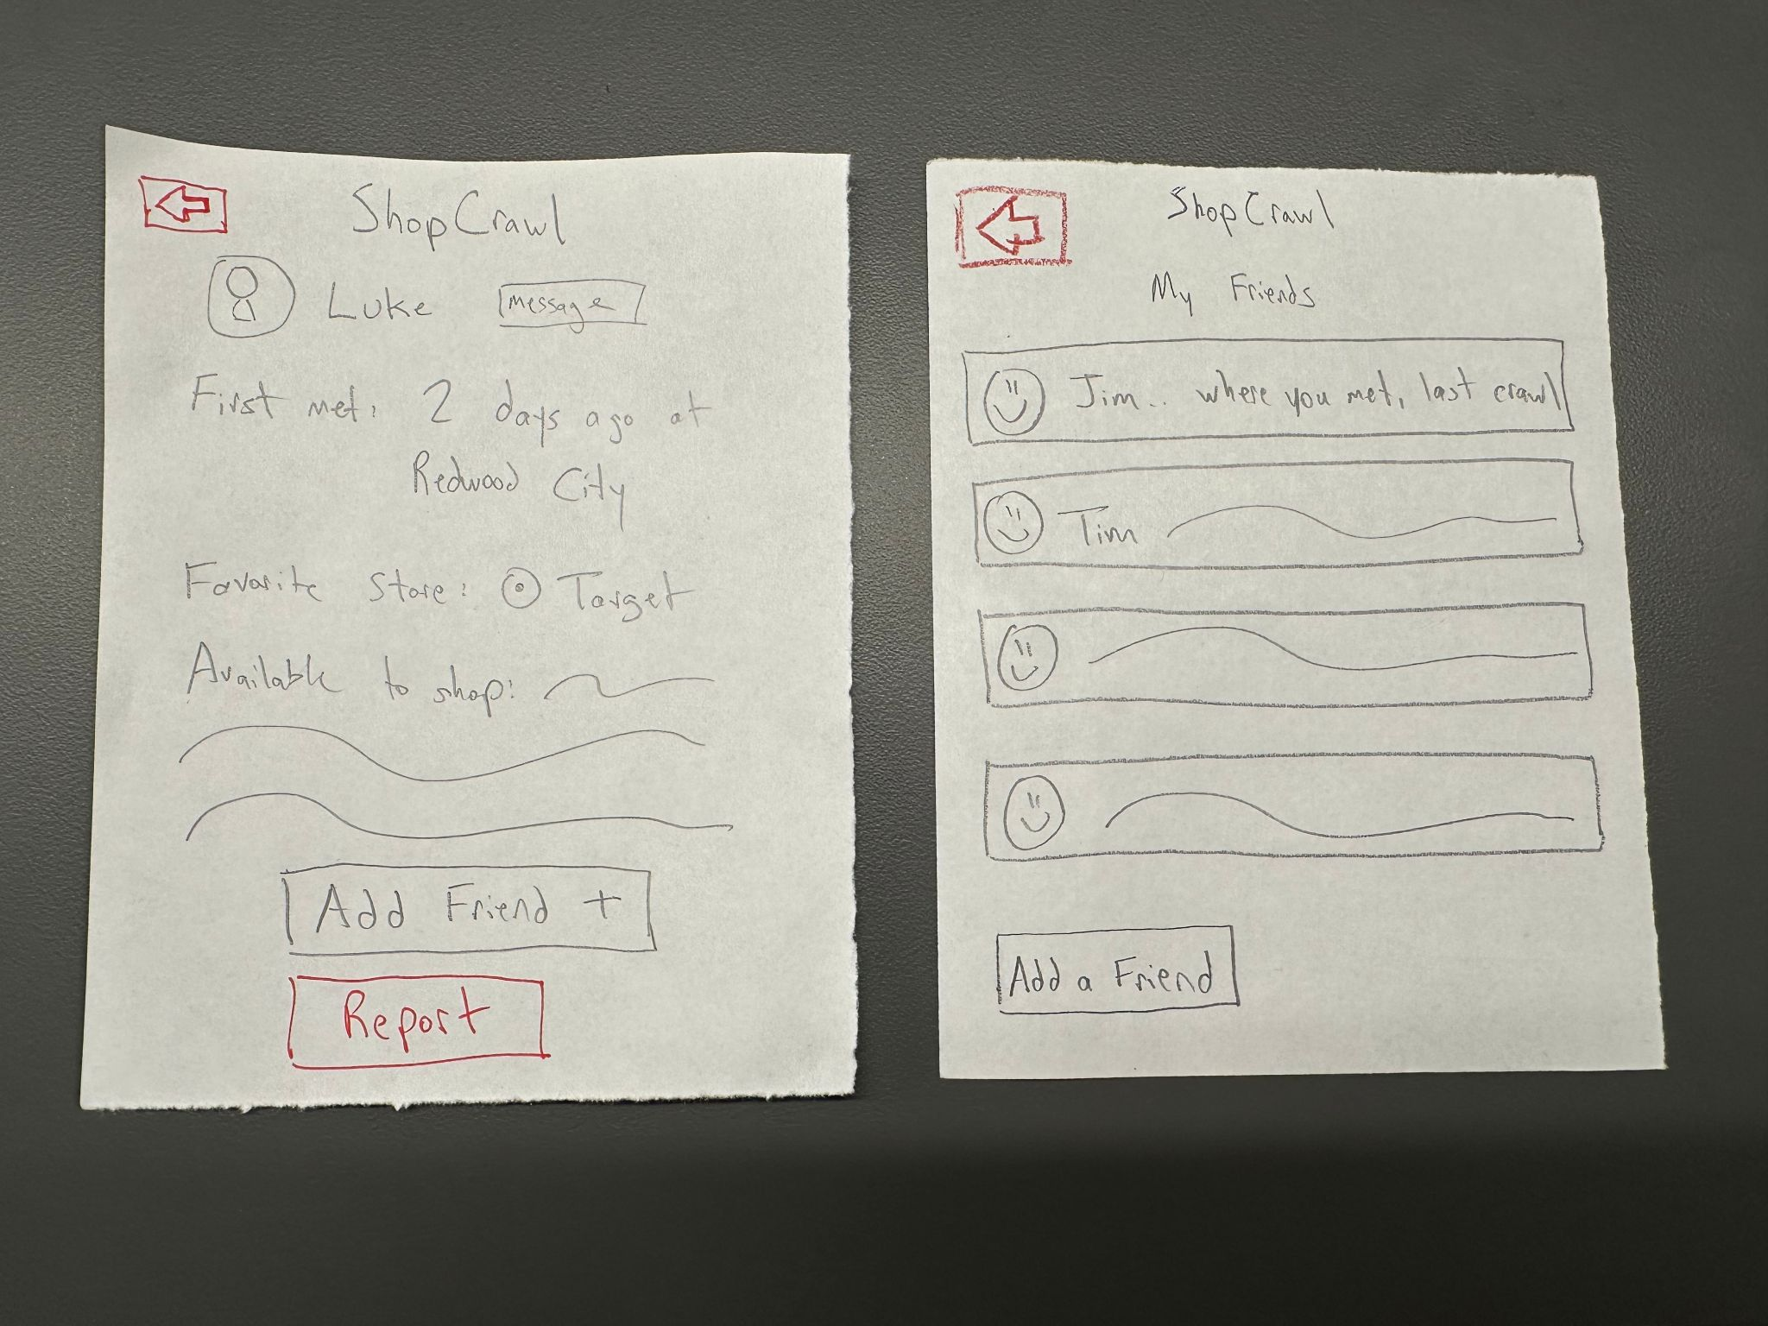
Core change 3: Standardized Layout & Hierarchy
Original Pages with inconsistent layout
After Changes: consistent placement of back button, aligned spacing and sizing of UI elements.

Slide 17
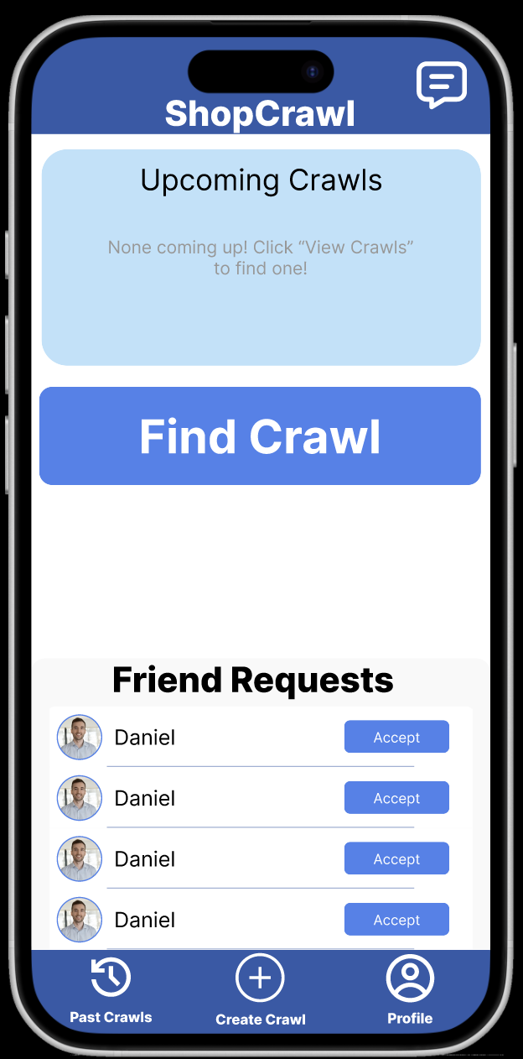
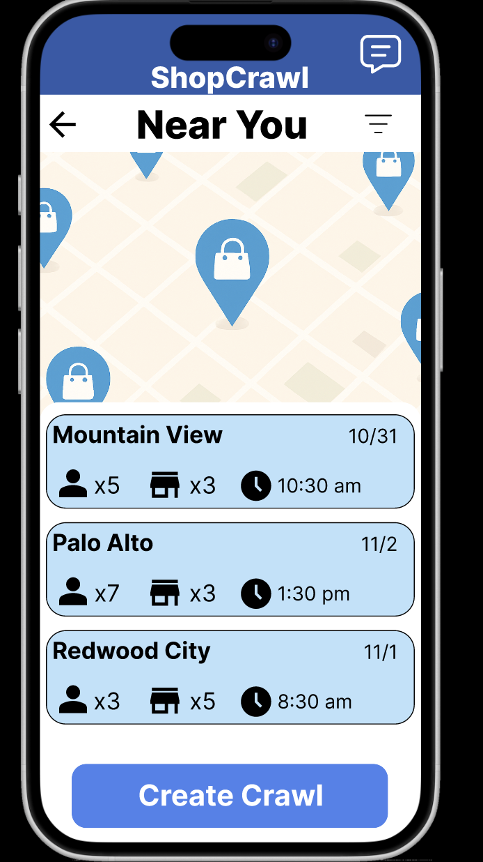
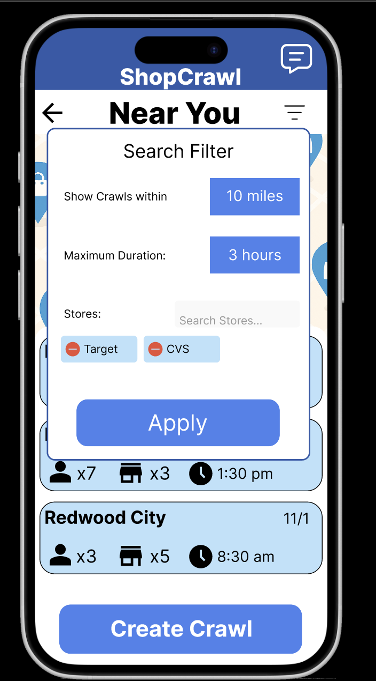
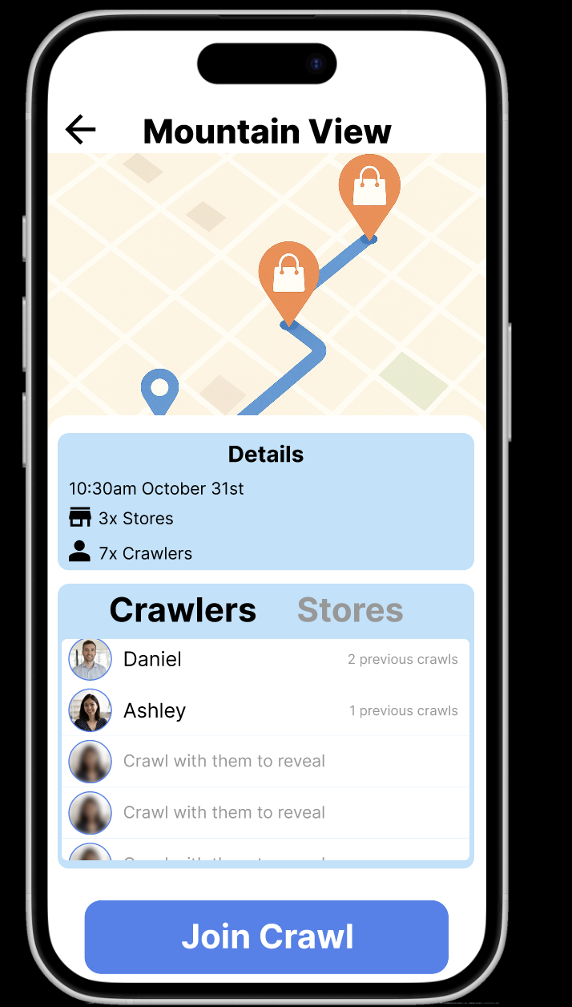
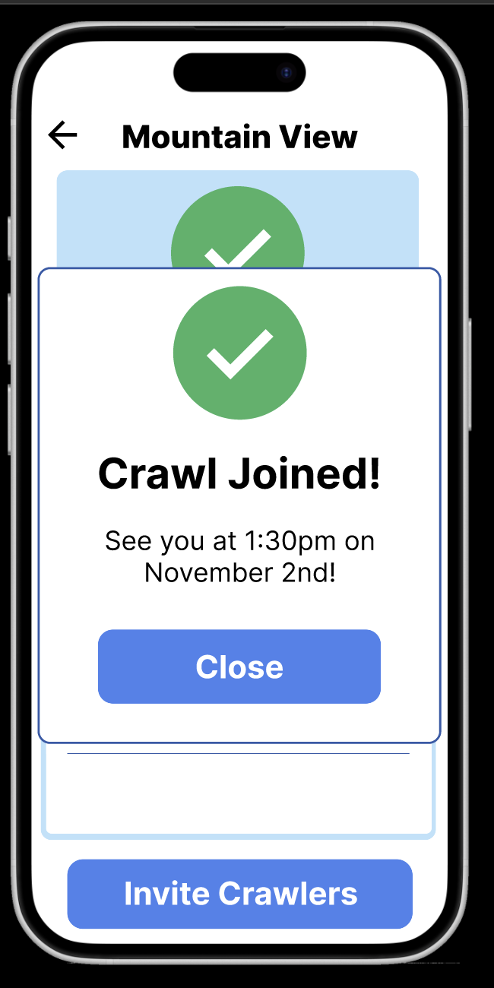
Simple Task flow:
Date
2.
3.
Our simple task is centered around how to join a crawl. Effectively we want to enable users to view available crawls, see where each crawl is going / people on it / stores on it, and then have the ability to join the crawl
Thus our task works as follows
Load into the home screen
Hit the find crawl button to open available crawls
Filter button for the crawls
Click on a crawl to see more information
  Click on the people and stores
Then click on the join crawl once you find one
4.
5.

Slide 18
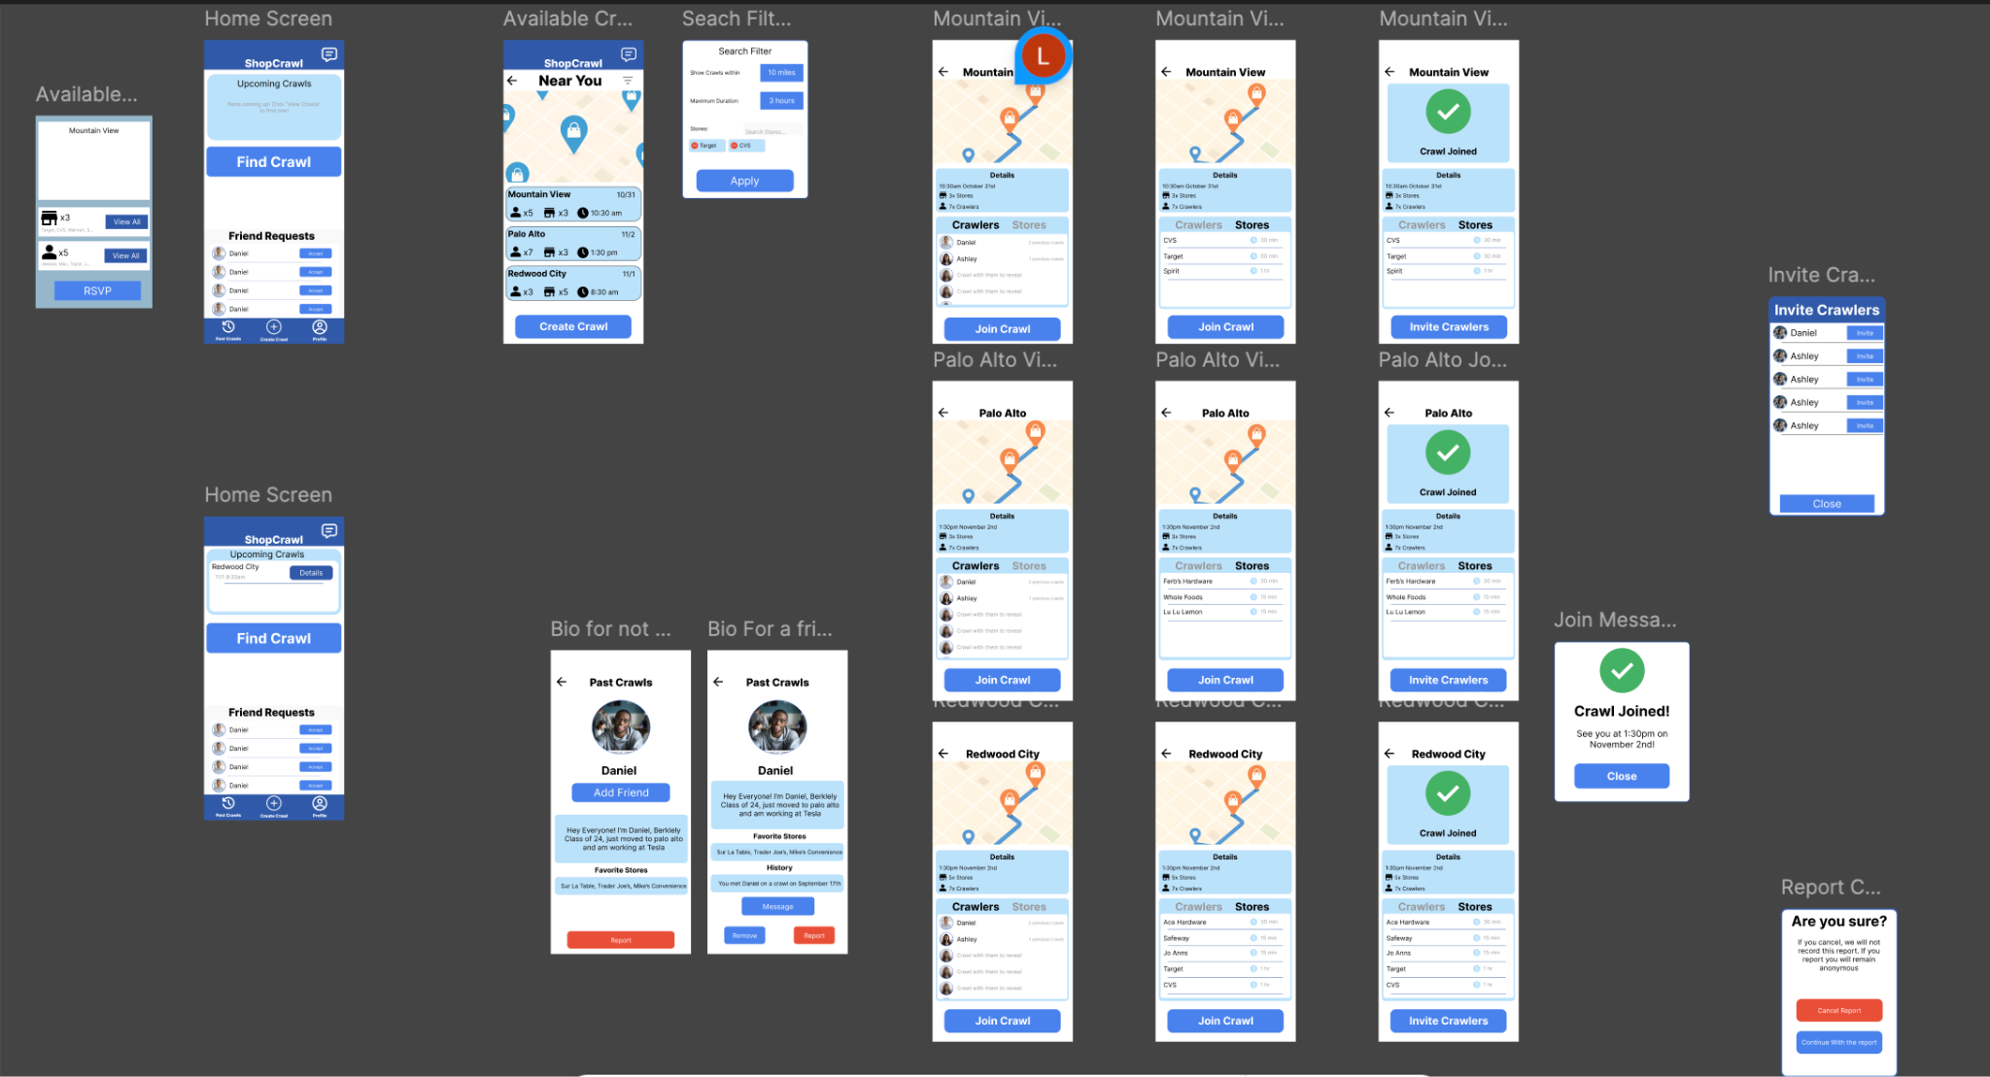
Simple Task All Screens Medium Fi:
Notes:
Here is the complete overview of the simple task medium fli. On the right is the home screen where it starts. There are two home screens as one represents when you first open the app and one is connecting to the other tasks for after you have joined a crawl Then you can click on the available crawls. From there you can see the details on each crawl. This we had hard coded to change depending on the crawl. This then leads to the complete a crawl and finalize

Slide 19
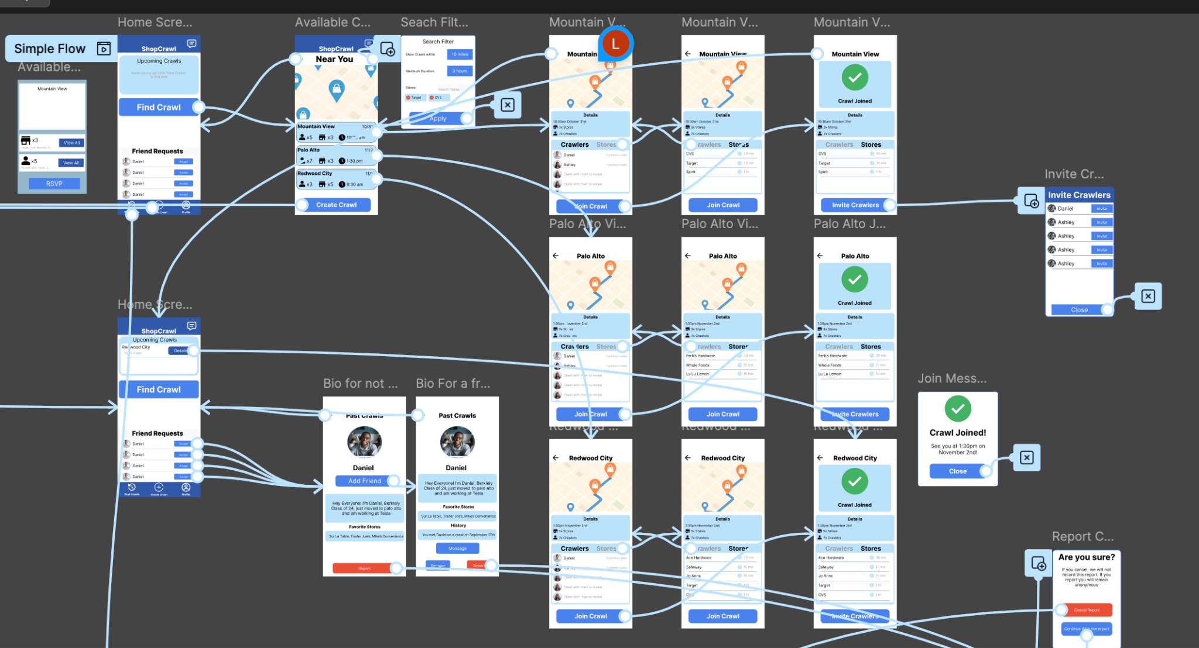
Simple Task flow all screens with Flow Direction
Notes:
This basically represents the flow of where each of the screens go to each other

Slide 20
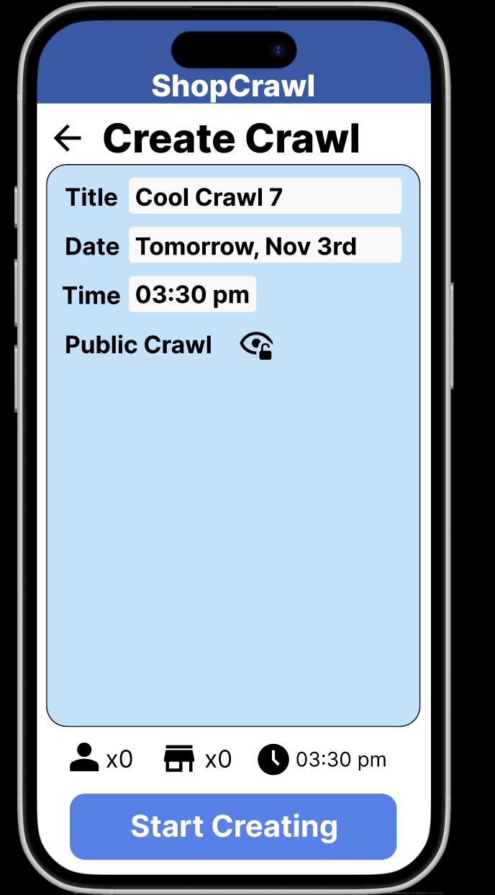
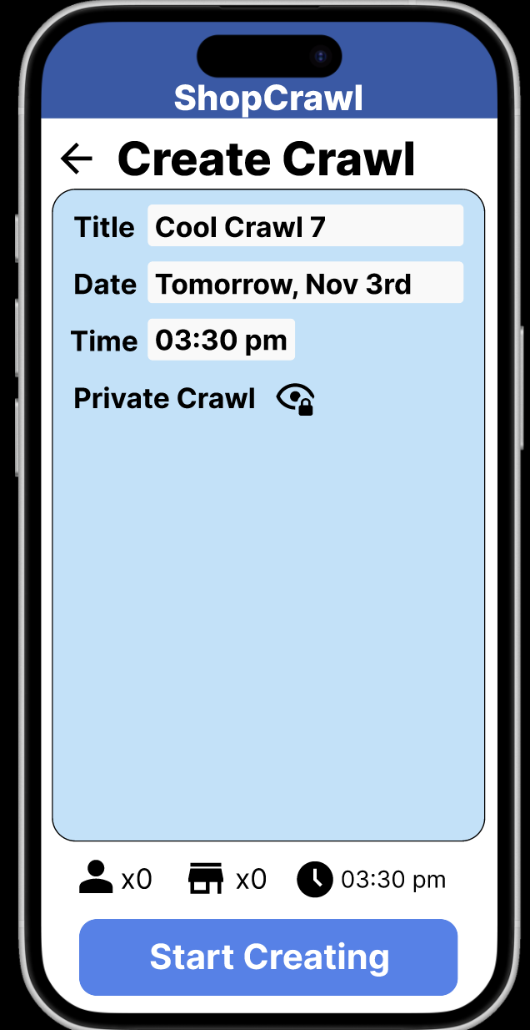
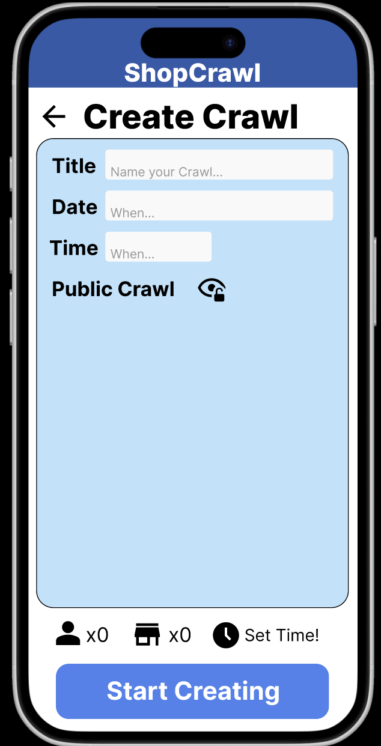
Medium Task flow part 1:
Our medium task is centered around how to create a crawl. We want users to seamlessly create a crawl by selecting a time, adding stores, inviting friends, and confirming the event.
Thus our task works as follows
Load into the home screen
Fill in crawl information
Click to toggle between private and public crawls
Date
2.
3.

Slide 21
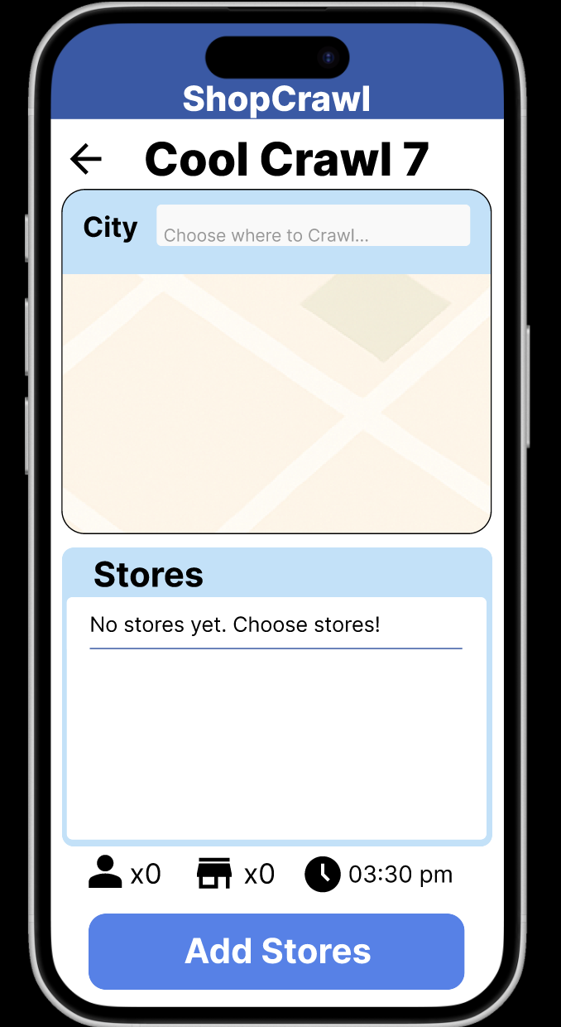
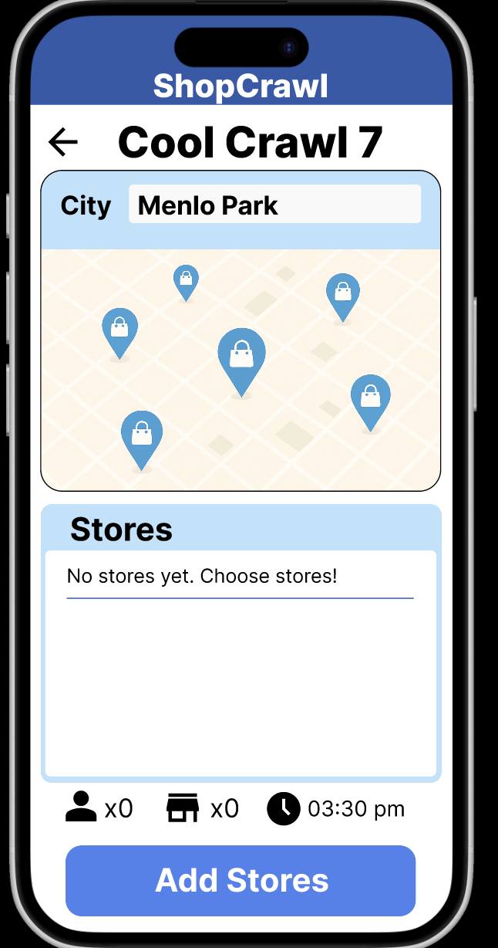
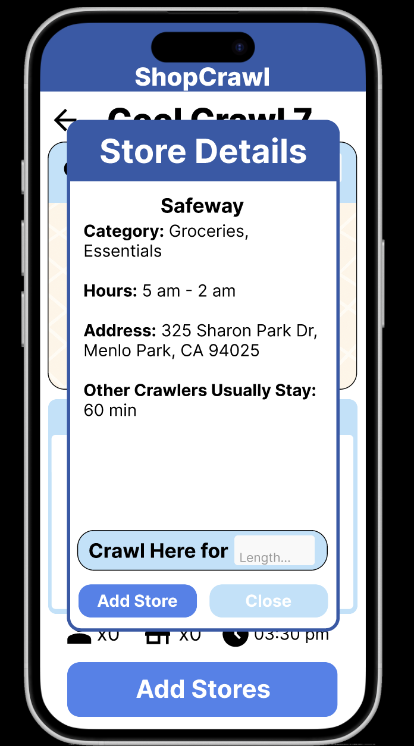
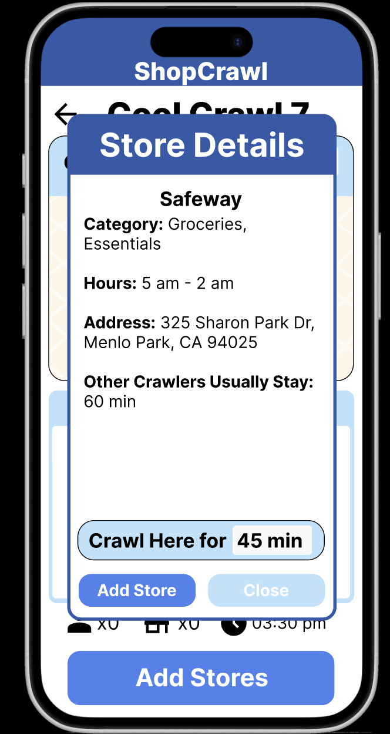
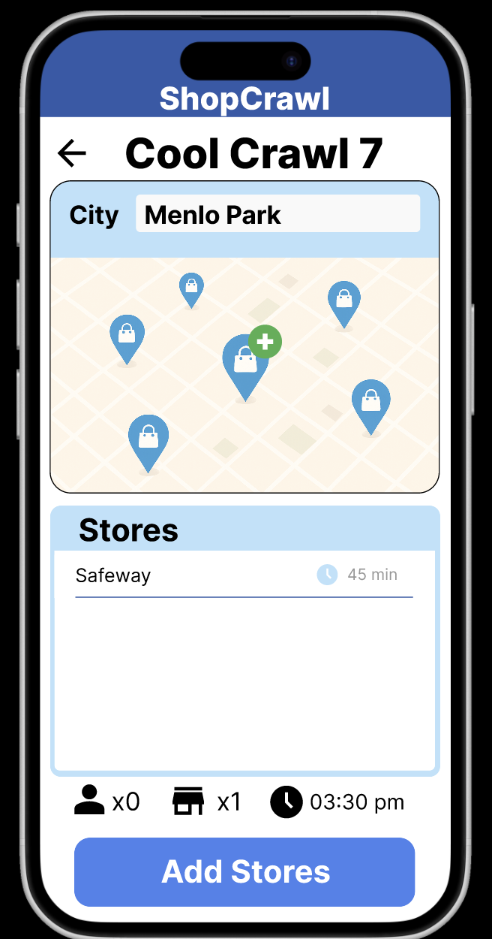
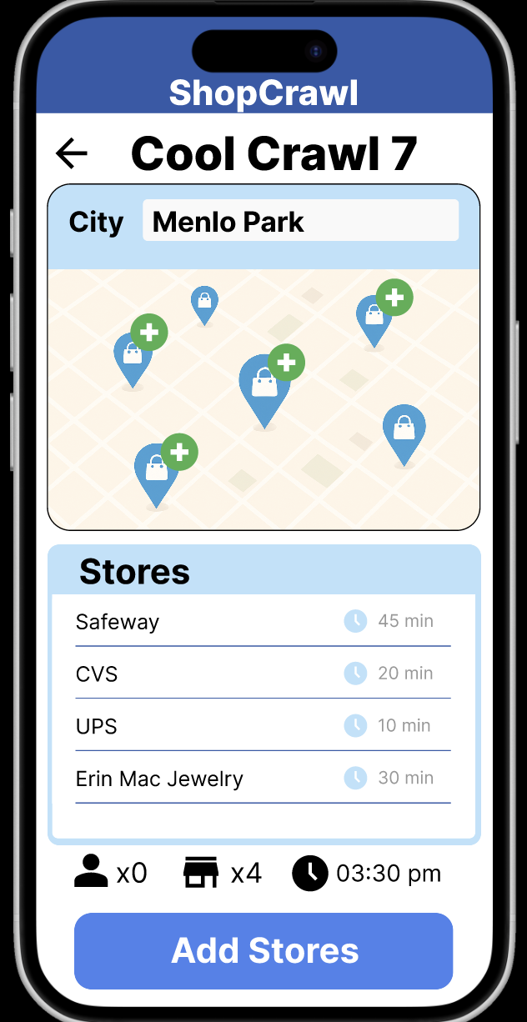
Medium Task flow part 2:
2.
3.
This part is centered around how to add a store
Load into the add store main screen
Search for the city you want to crawl
Click on the map for more details
Add a time
Add the store
Click to add more stores each and then once finished click the button on the bottom to move onto the add crawlers section
4.
5.
6.

Slide 22
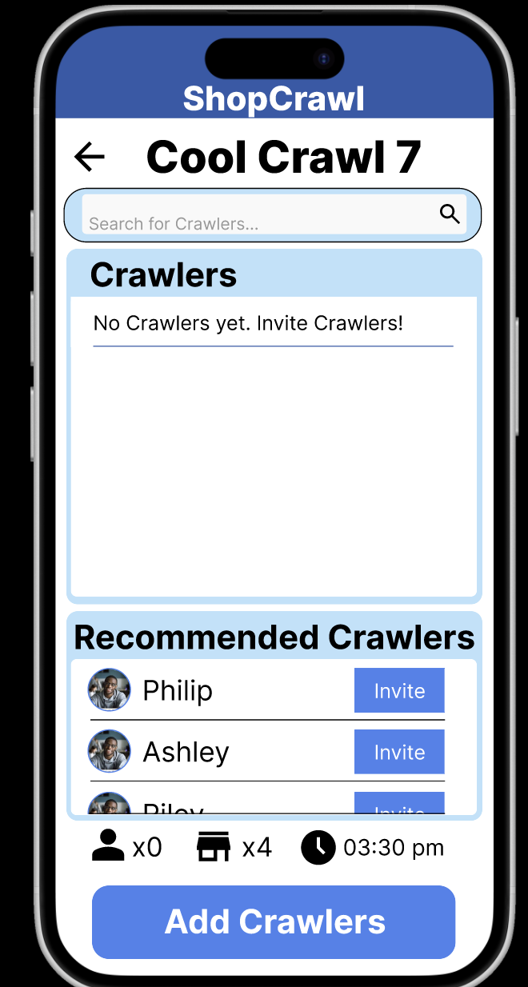
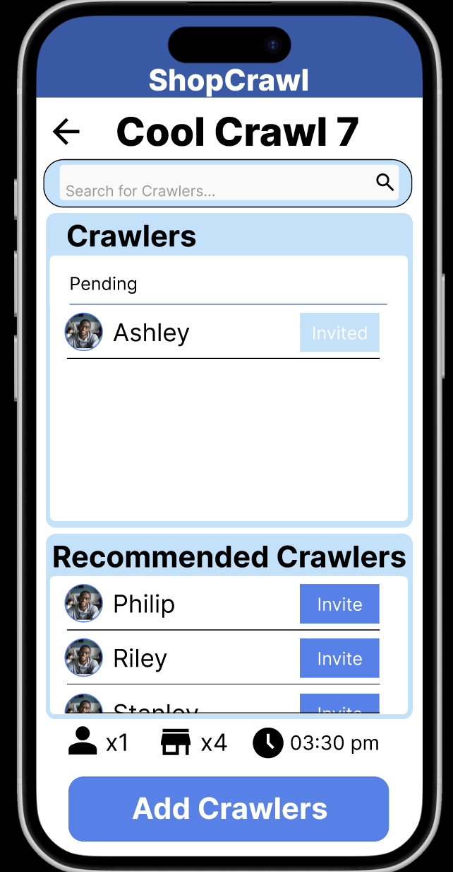
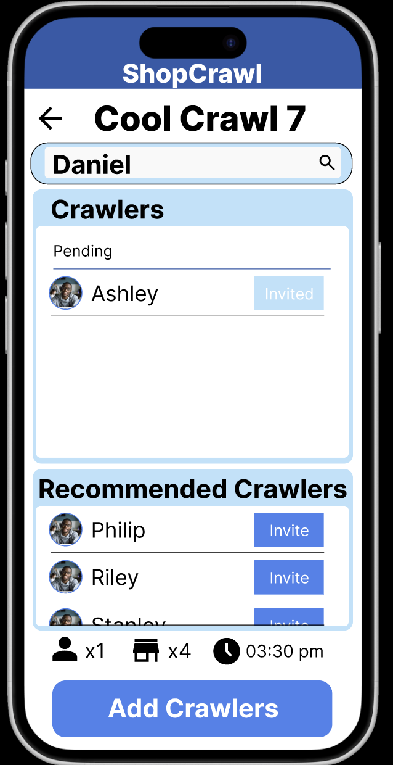
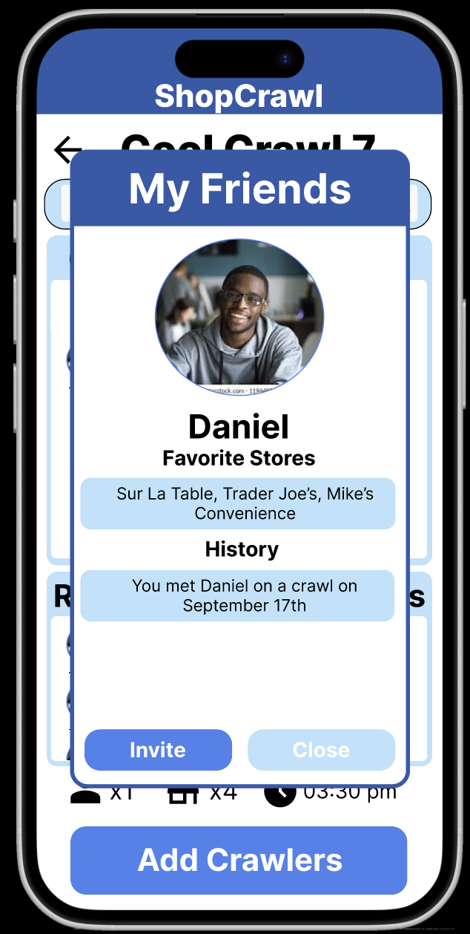
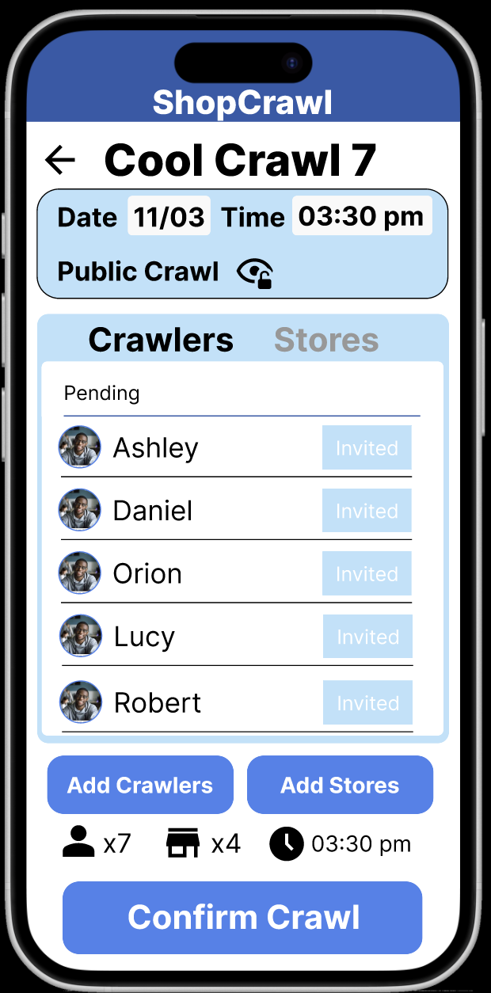
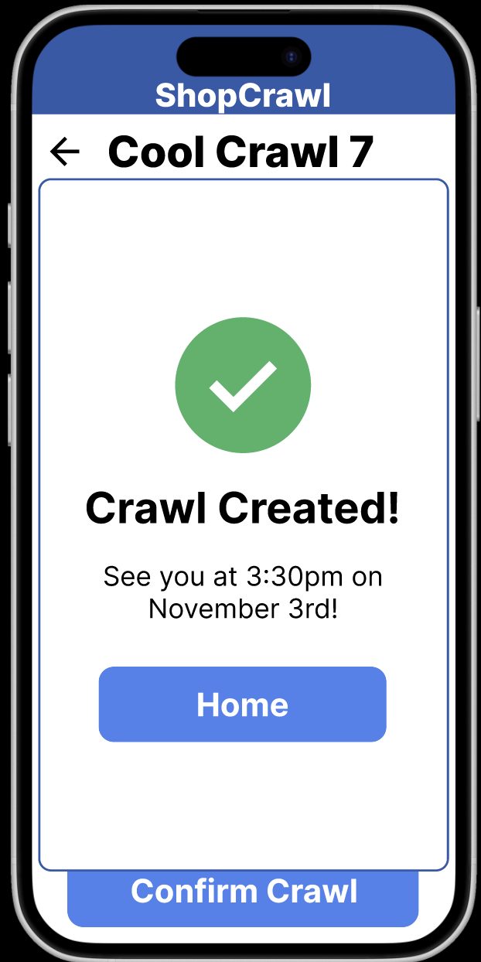
Medium Task flow part 3:
Date
2.
3.
This part is centered around how to add a crawler
Load into the add crawlers main screen
Invite a recommended crawler
Search for crawlers
  Add the person you searched for
Once finished, click the add crawlers to get to the final screen
Click to confirm the crawl, opens the crawl confirmed page
3a.
4.
5.

Slide 23
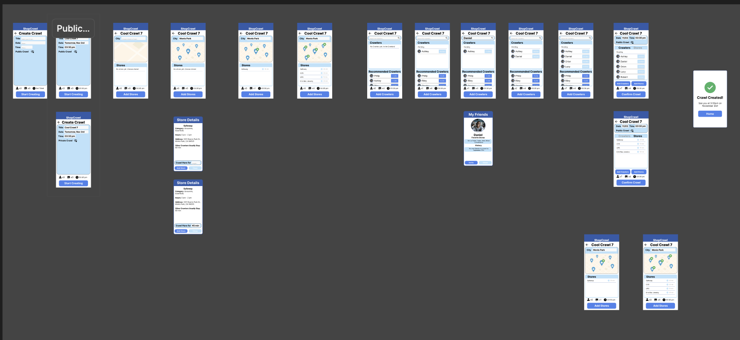
Moderate Task All screens
Notes:
This slide shows the overview of our moderate task screens, which together make up the Create Crawl flow. You can see every step here laid out visually from starting on the home screen to setting details, adding stores, inviting crawlers, and confirming the crawl.

Slide 24
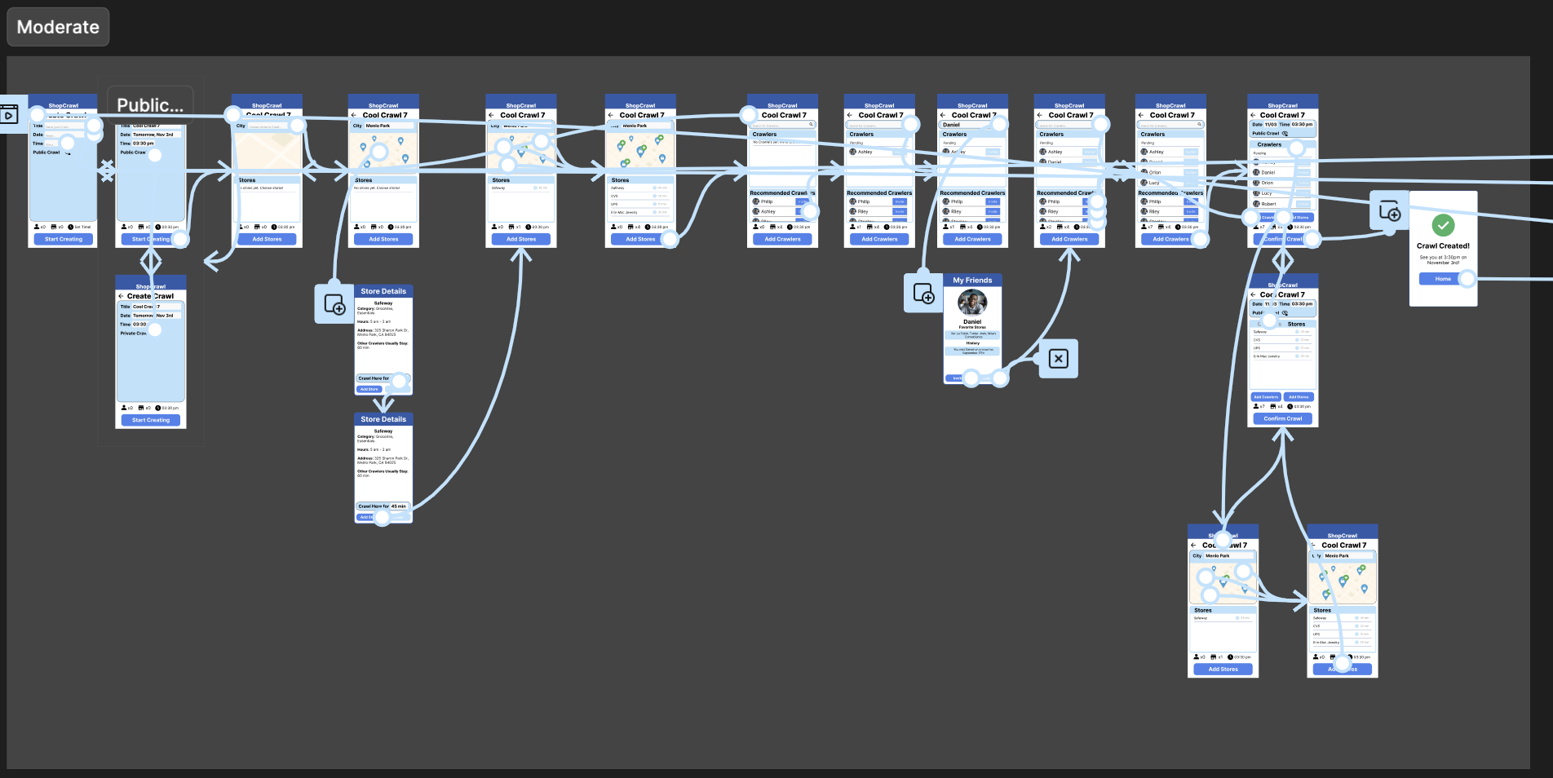
Moderate Task All Screens with Flow Direction
Notes:
This slide shows our moderate task prototype flow, visualizing how users move through the key steps within the task. We’ve already discussed the overall path through the crawl creation process, but here you can see how each screen connects and transitions.
One thing that’s really important to note here is how the flow supports backwards navigation. We made a point to design clear and consistent back paths so users can easily move from point B back to point A without getting lost

Slide 25
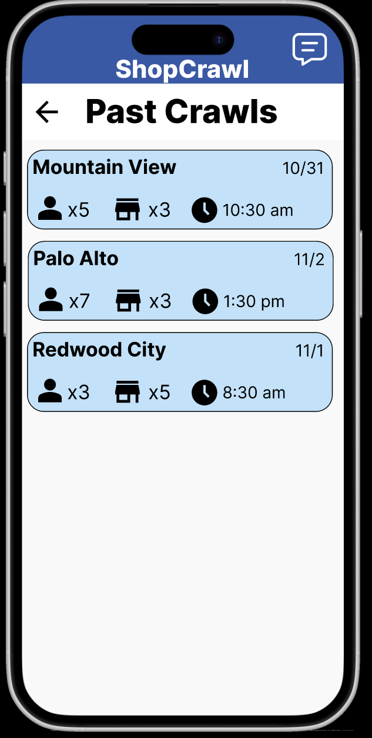
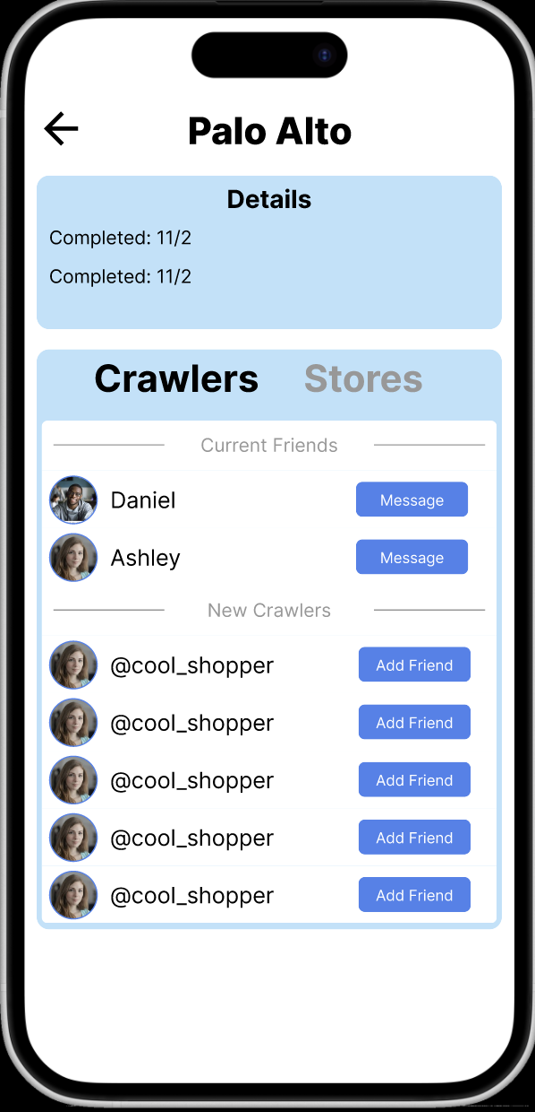
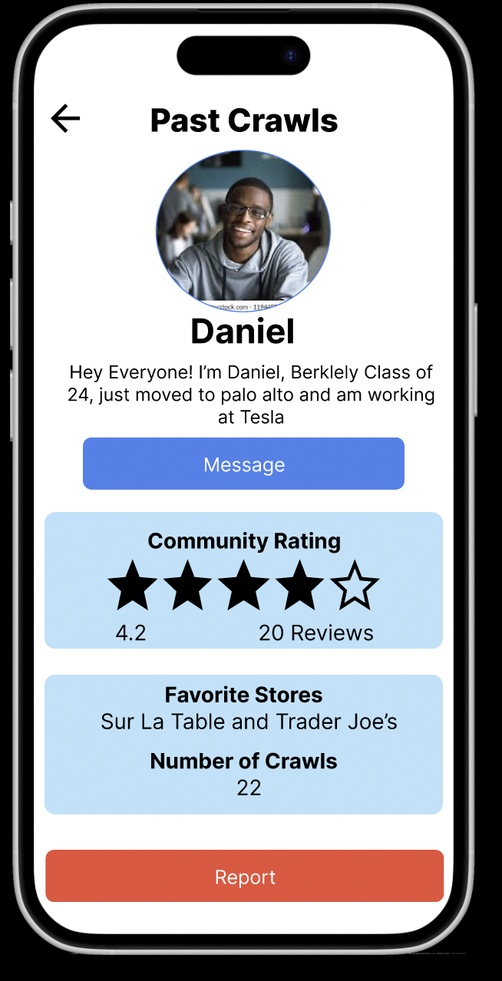
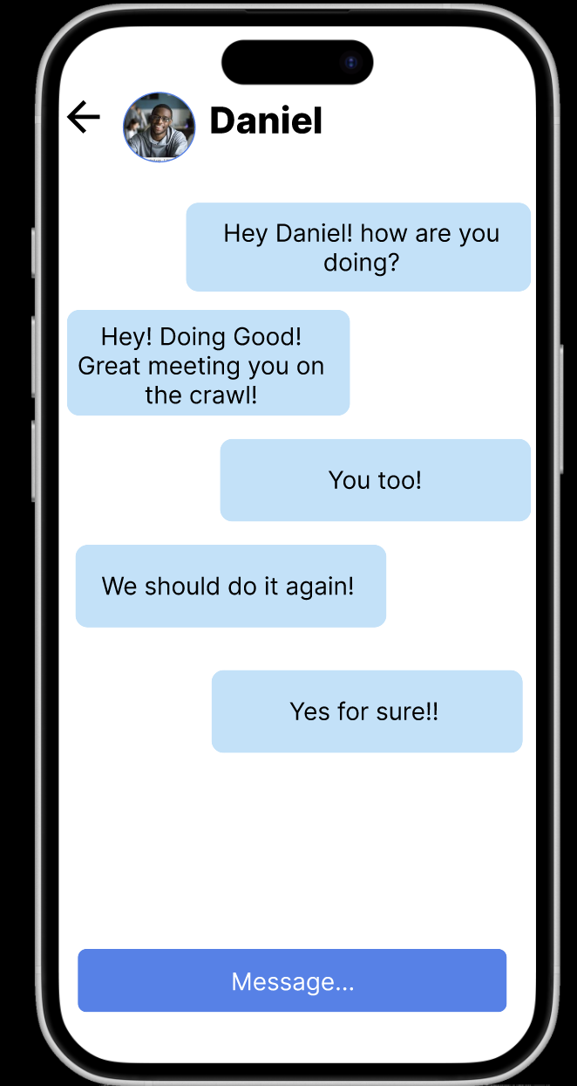
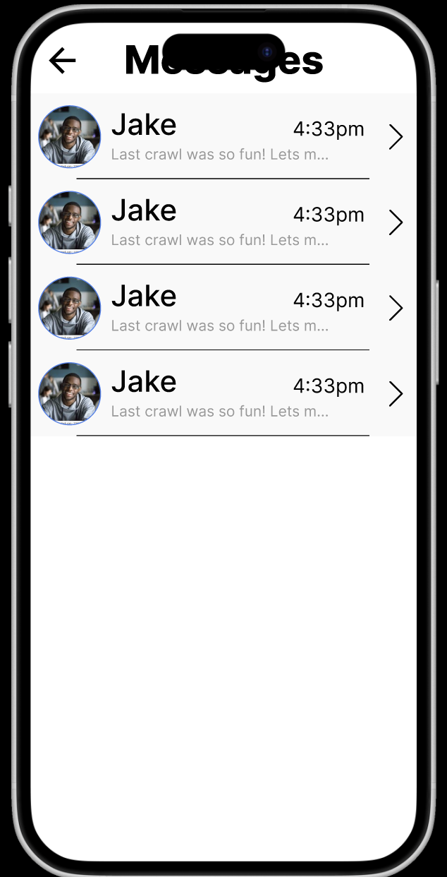
Complex Task flow part 1:
Date
2.
3.
Our complex task is centered around connecting with people from past crawls. Thus we focus on how we can make it easy for you to find previous crawlers, message and stay in contact.
Past crawls home page. See all the past crawls
Click on a past crawl to get to the information. See the people in the crawl, who of them you are friends with currently
Click on a person to bring up their bio. Can message, report, or add / remove friend
Message opens up messaging app
Back on messages opens up history of messages
4.
5.

Slide 26
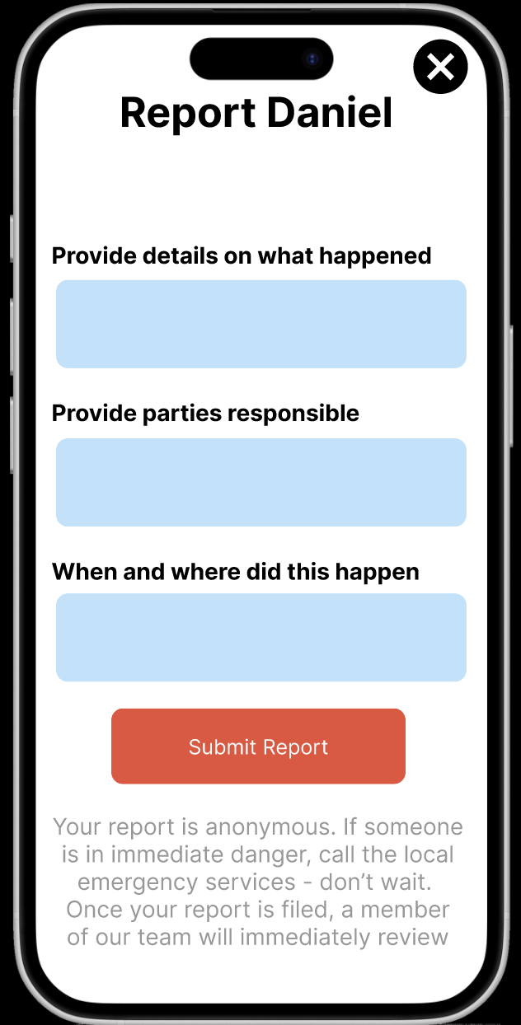
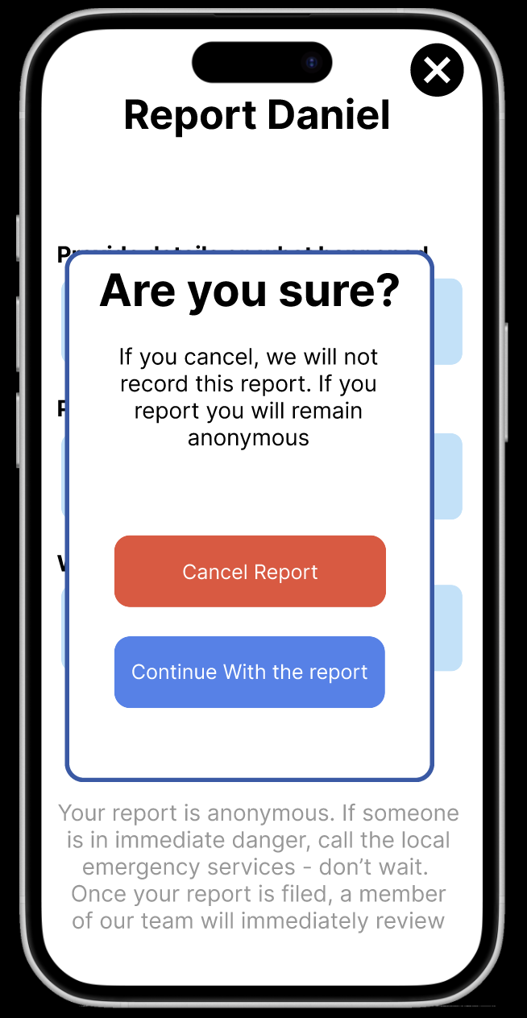
Complex Task flow part 2
A core goal of ours with this new prototype was to increase the safety, thus adding reporting fields was important and we implemented as follows
Click on the report button on a person’s bio
A report button appears. This asks the user to fill the details. It also emphasizes that the report is anonymous and that if there is an emergency to call local services.
If you want to cancel the report, it asks if you are sure to make sure that someone is actively trying to not report the person rather than accidentally cancelling
2.
3.

Slide 27
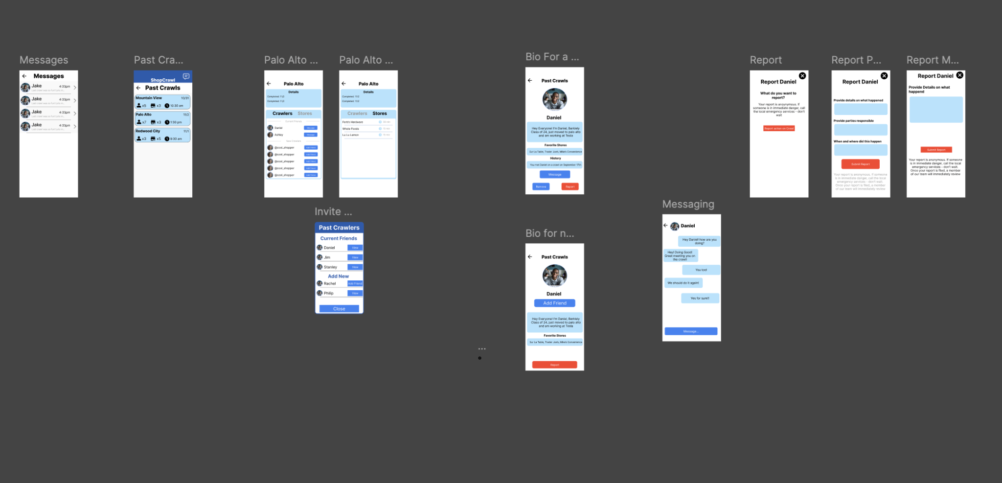
Complex Task All screens
Notes:
This flow represents our full set of connected screens in the prototype. On the far left is the Home Screen displaying Past Crawls. From there, users can select a specific crawl to view its details. Since our focus is on building social connections, each crawl allows users to click on a participant to open that person’s Bio Page.
From the bio, users can add or remove friends, open messages, or report another user. Navigating to messages takes the user to a one-on-one chat, and pressing “Back” returns to the Messages Overview, located on the left side of the prototype.
Additionally, the Report flow lets users select a reason, provide details, and either submit or cancel the report. Together, these screens demonstrate the core interaction paths for connecting with others, managing relationships, and ensuring safety within the ShopCrawl experience.

Slide 28
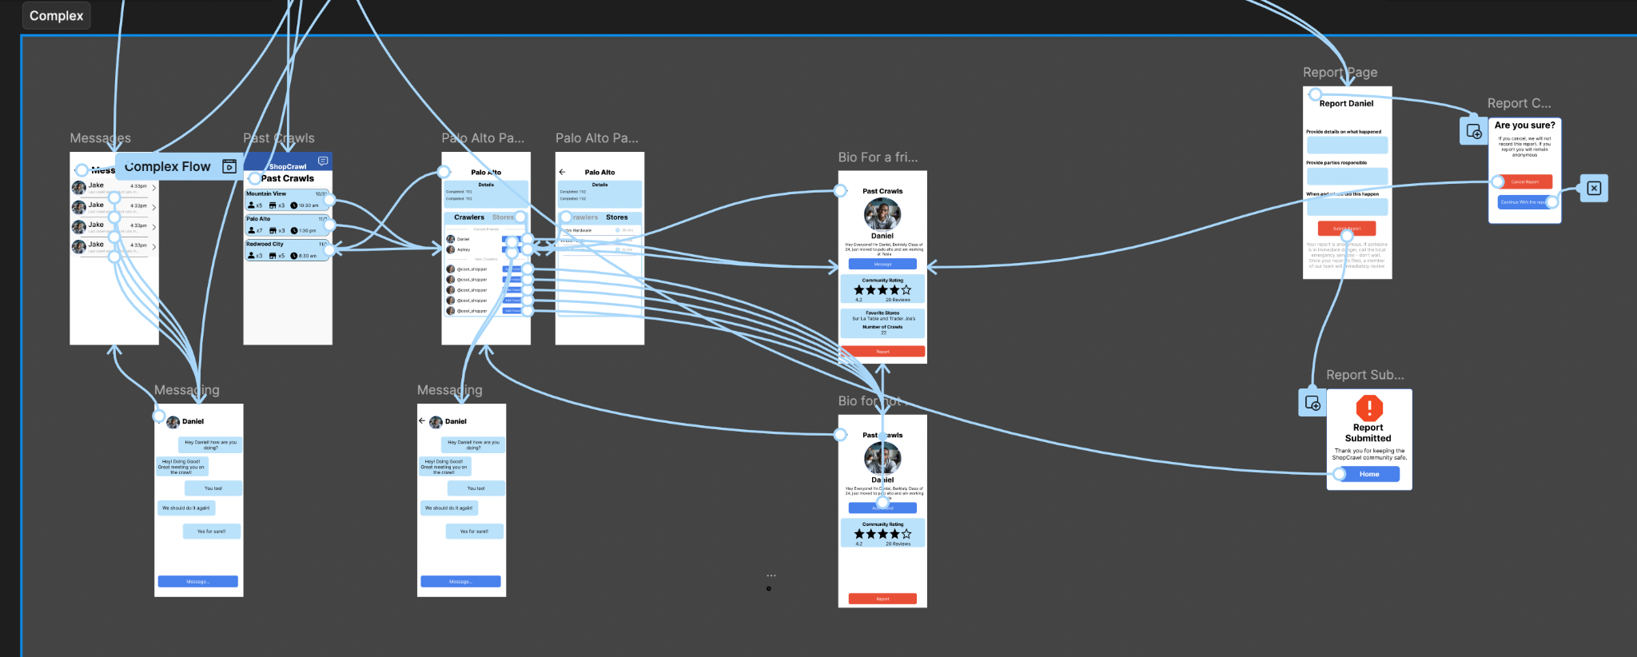
Complex Task All screens with Flow Direction
Notes:
This screen displays the full prototype flow with all overlay connections visible. The arrows illustrate how each screen transitions to the next and how tasks interconnect across the app. While the generalized flow was already discussed in previous slides, this view helps visualize the entire interaction structure in one place. You can see how each user action links to the next task, emphasizing the interconnectedness between key usability goals.

Slide 29
Tools: Pros and Cons of Figma
We decided to use Figma after a careful debate. To start here are some of the pros and cons that we debated between:
Pros:
Very quick to build and iterate on complex designs
Allows for high-fidelity visuals that closely resemble a real product
Easy to organize and test multiple flows in one shared workspace
Enables collaborative editing and feedback in real time
Cons:
Difficult to test interactions on a phone natively; most testing happens on desktop, which reduces realism in mobile experiences
Limited ability to handle true user input (e.g., typing, dynamic text, conditional behavior)
Simulated transitions can appear smooth, but they don’t represent actual system performance or data flow
Can become cluttered with many overlapping prototype connections, making edits slower as the design grows
From this, we decided that the pros of speed and flexibility to building these complex screens outweigh the limitations of fully interactive user input

Slide 30
Core Limitations
The following are the key limitations that we ran still have in our prototype:
Limited user input flexibility: Most fields and buttons are preset or static and users can’t truly customize inputs like adding specific stores or crawlers.
Hard-coded flow: Several buttons and screens are purely illustrative; some clickable areas don’t lead anywhere, serving only to show layout and intended navigation
Low UI design: We aim to make the design more fun and active at a future time frame, right not is rather basic and not as enjoyable
Why these limitations? We wanted to focus on concept validation. We prioritized testing the overall flow and design direction before implementing detailed interactivity or data-driven features.
These limitations have an impact on having a true social experience for users of the prototype, since they cannot connect to real life Crawlers, or search for real nearby stores. The prototype still succeeds in allowing users to explore the core concept of ShopCrawl, and to learn the UI before we solve these limitations in later prototypes.

Slide 31
Hard-coded and Wizard-of-Oz features
Hard coded:
Several buttons and text fields are non-functional placeholders used to demonstrate layout and navigation (the messages that exist in the messaging screen, can’t send more in)
Profiles, store listings, and crawler cards are pre-loaded visuals as they can’t be edited, searched, or customized by the user.
Navigation links (like back buttons or confirmation actions) simply move to preset screens rather than processing any real data.
Wizard of Oz:
The “Create Crawl” page auto-fills fake text when clicked, imitating user input.
The “Confirm Crawl” button brings up a pre-made success screen, mimicking a completed process.
The “Report Submission” screen instantly displays a message, faking a server response.

Slide 32
Link to figma:https:
//www.figma.com/proto/oDg452S4xNPsIPNNnZN7NA/Shop-Crawl-Low-fi-Prototype?node-id=0-1&t=hXtQnlGvKkcDqFo5-1

